Slide 1
PPT ON SYSYEM DEVELOPMENT
LIFE CYCLE
DEPARTMENT OF COMPUTER
CLASS- BCA-Vth Semester
Submitted By:
Pardeep Kaur

Slide 2
The System Development Life Cycle
What is an information system (IS)?
Hardware, software, data, people, and procedures that work together to produce quality information
System—Set of components that interact to achieve common goal
Businesses use many types of systems

Slide 3
The System Development Life Cycle
What are the phases of the system development cycle?
Phase 2. Analysis
Phase 1. Planning
Conduct preliminary investigation
Perform detailed analysis activities:
  Study current system
  Determine user requirements
  Recommend solution
Phase 3. Design
Review project requests
Prioritize project requests
Allocate resources
Identify project development team
Acquire hardware and software, if necessary
Develop details of system
Phase 5. Support
Phase 4. Implementation
Conduct post-implementation system review
Identify errors and enhancements
Monitor system performance
Develop programs, if necessary
Install and test new system
Train users
Convert to new system

Slide 4
The System Development Life Cycle
What are guidelines for system development?
Arrange tasks into phases (groups of activities)
Involve users (anyone for whom system is being built)
Develop clearly defined standards (procedures company expects employees to follow)

Slide 5
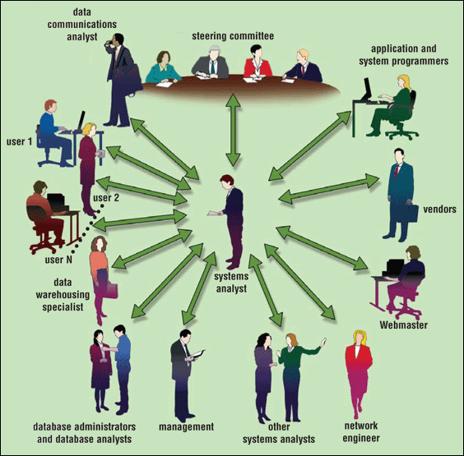
The System Development Life Cycle
Who participates in the system development life cycle?

Slide 6
The System Development Life Cycle
What is a systems analyst?
Responsible for designing and developing information system
Liaison between users and IT professionals

Slide 7
The System Development Life Cycle
What is the project team?
Formed to work on project from beginning to end
Consists of users, systems analyst, and other IT professionals
Project leader—one member of the team who
manages and controls project budget and schedule

Slide 8
The System Development Life Cycle
What is feasibility?
Operational feasibility
Measure of how suitable system development will be to the company
Four feasibility tests:
Schedule feasibility
Economic feasibility (also called cost/benefit feasibility)
Technical feasibility

Slide 9
The System Development Life Cycle
What is documentation?
Collection and summarization
of data and information
Includes reports, diagrams,
programs, and other deliverables

Slide 10

The System Development Life Cycle
What are six data and information gathering techniques?
  Review documentation
  Observe
  Questionnaire
  Interview
  Joint-application
  design (JAD) session
  Research

Slide 11
The System Development Life Cycle
What are some reasons to create or modify an information system?
To correct problem
in existing system
To improve
existing system
Outside group may
mandate change
Competition can
lead to change

Slide 12
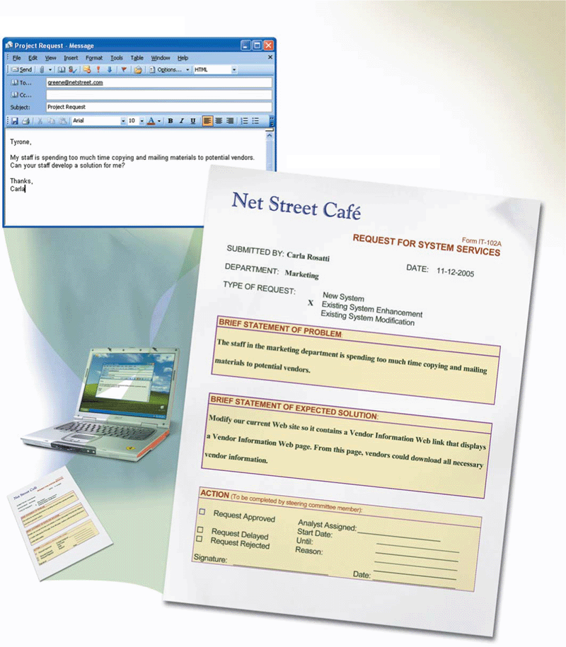
The System Development Life Cycle
What is a request for system services?
  Formal request for
  new or modified
  information system
    Also called
    project request

Slide 13
The System Development Life Cycle
What is the planning phase?
Begins when steering committee receives project request
Steering committee—decision-making body for the company
Function of committee:
Review and approve project requests
Prioritize project requests
Allocate resources
Form project development team for each approved project

Slide 14
The System Development Life Cycle
What is the analysis phase?
Conduct preliminary investigation, also
called feasibility
study
Perform detailed analysis

Slide 15
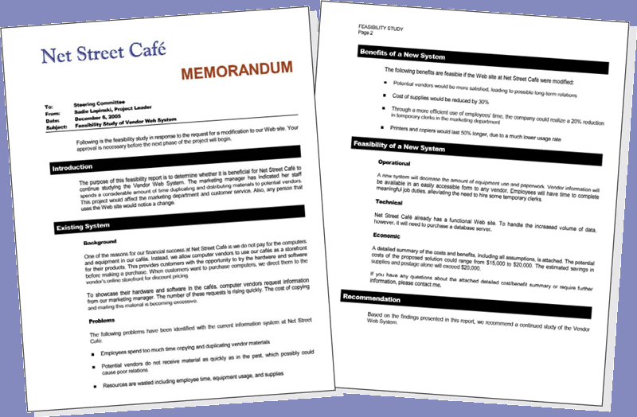
The System Development Life Cycle
What is the preliminary investigation?
Determine exact nature of problem or improvement and whether it is worth pursuing
  Findings are presented in feasibility report, also known as a feasibility study

Slide 16
The System Development Life Cycle
What is detailed analysis?
1. Study how current system works
2. Determine user’s wants, needs, and requirements
3. Recommend solution
Sometimes called logical design

Slide 17
The System Development Life Cycle
What is the
system proposal?
Assesses feasibility
of each alternative solution
Presented to steering committee, which decides how system will be developed
Recommends the most feasible solution for the project

Slide 18
The System Development Life Cycle
What are possible solutions?
Horizontal market software—meets needs of many companies
Buy packaged software—prewritten software available for purchase
Vertical market software—designed for particular industry
Write own custom software—software developed at user’s request
Outsource—have outside source develop software

Slide 19
The System Development Life Cycle
What is the design phase?
Acquire hardware and software
Develop all details of new or modified information system

Slide 20
The System Development Life Cycle
What is needed to acquire new hardware and software?
  Identify all hardware and software requirements of new or modified system
Talk with other
systems analysts
Surf Web
Visit vendors’ stores
Read print and online trade journals, newspapers, and magazines

Slide 21
The System Development Life Cycle
What are three basic documents used to summarize technical specifications?
Identifies product(s) you want
Vendor quotes price(s) for listed product(s)
Request for quotation (RFQ)
Request for proposal (RFP)
Vendor selects product(s) that meet(s) your requirements and then quotes price(s)
Less formal method that uses standard form to request information about product or service
Request for information (RFI)

Slide 22
The System Development Life Cycle
How do systems analysts test software products?
  References from vendor
  Talk to current users of product
  Product demonstrations
  Trial version of software
  Benchmark test measures performance

Slide 23
The System Development Life Cycle
What is a detailed design?
Detailed design specifications for components in proposed solution
Includes several activities
Database
design
Input and
output design
Program
design

Slide 24
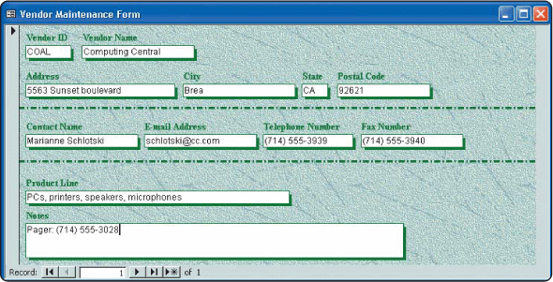
The System Development Life Cycle
What is a mockup?
  Sample of input or output that contains actual data

Slide 25
The System Development Life Cycle
What is a prototype?
Working model of
proposed system
Beginning a prototype too early may lead to problems

Slide 26
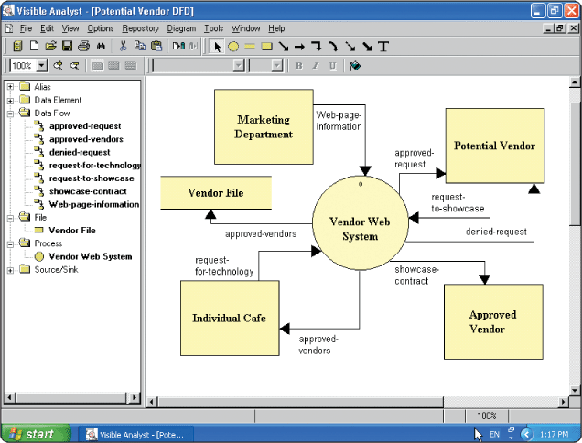
The System Development Life Cycle
What is computer-aided software engineering (CASE)?
  Software tools designed to support activities of system development cycle

Slide 27
The System Development Life Cycle
What is the implementation phase?
  Purpose is to construct, or build, new or modified system and then deliver it to users
Convert to new system
Train users
Install and test new system
Develop programs

Slide 28
The System Development Life Cycle
What are the three types of tests performed by system developers?
Unit Test
Systems test
Verifies each individual program works by itself
Verifies all programs in application work together
Integration Test
Verifies application works with other applications

Slide 29
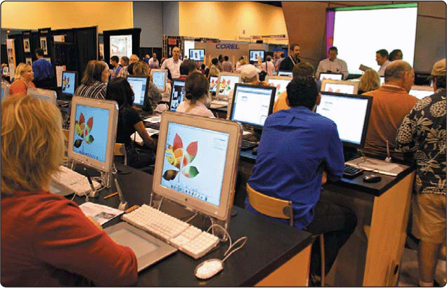
The System Development Life Cycle
What is training?
  Showing users exactly how they will use new hardware and software in system

Slide 30
The System Development Life Cycle
Conduct post-implementation system review—meeting to find out if information system is performing according to expectations
Identify errors
What is the support phase?
  Provides ongoing assistance after system is implemented
Identify enhancements
Monitor system performance

